Slide 1

Python
Introduction

Slide 2
1.1 Python Syntax

Slide 3
Python syntax is the way code should be written for it to be understood

Slide 4
Python code is written as a sequence of statements
Python uses indentation to indicate the start and end of blocks of code

Slide 5
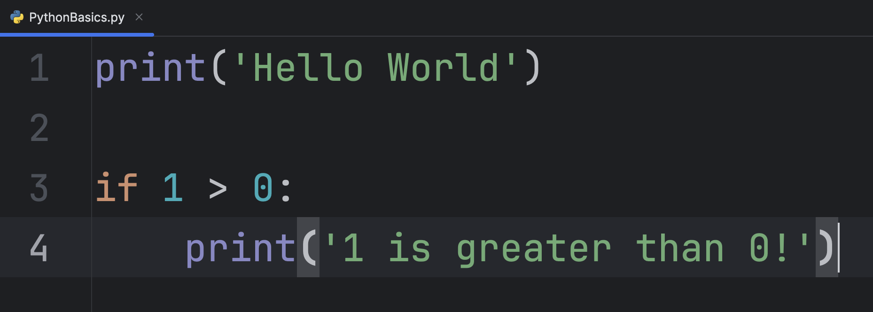
Statement
Indentation

Slide 6
Printing is one of the simplest and most useful python statements
It is used when we want to display information

Slide 7
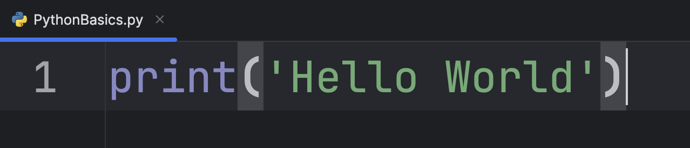
Quotation Marks

Slide 8
Try it Yourself!
Write a program that prints your name (don’t forget to use quotes!)

Slide 9
A print statement is often used with variables

Slide 10
1.2 Variables

Slide 11
A variable is a ”container” that stores a value, which can change throughout a program

Slide 12
You can think of a variable as a box that holds information

Slide 13
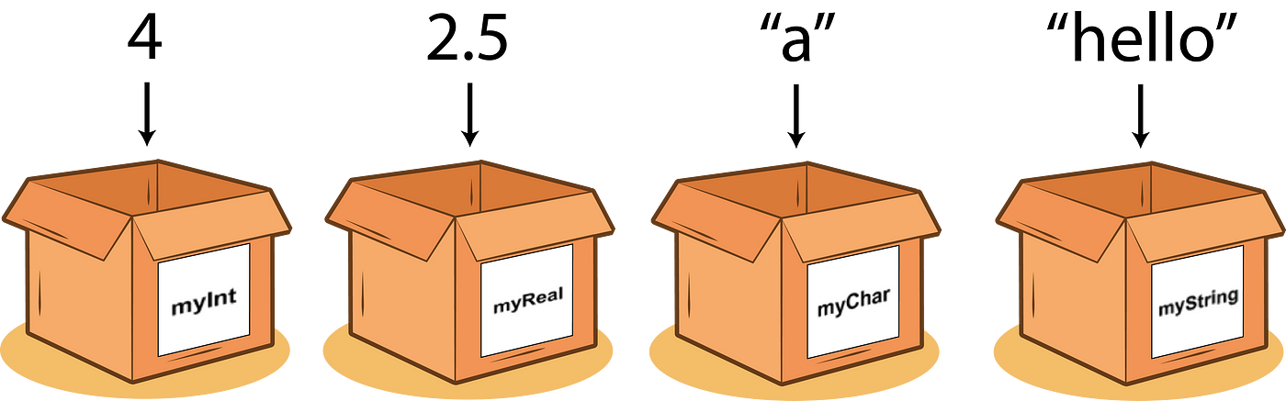
You can think of a variable as a box that holds information

Slide 14
To make a variable you assign a name to a value

Slide 15
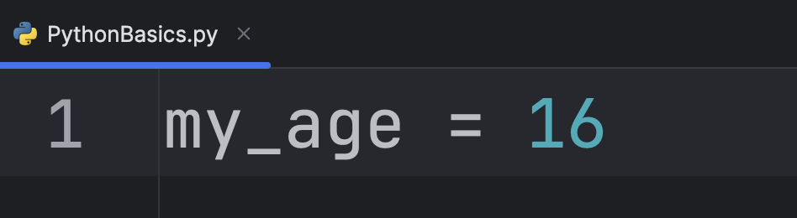

Slide 16
Variable names have rules

Slide 17
1. A variable name must start with a letter or underscore (_)

Slide 18
2. A variable name can only contain letters, numbers and underscores (A-z, 0-9, _)

Slide 19
3. Variable name are case sensitive (name, Name, and NAME are 3 different variables)

Slide 20
Try it Yourself!
Create a variable that holds your age. Feel free to name it what you want but keep the rules in mind.

Slide 21
Variables can hold different types of data. Lets take a look.

Slide 22
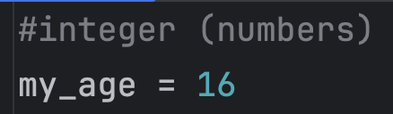
Integers (int) are whole numbers without decimals
Example:

Slide 23
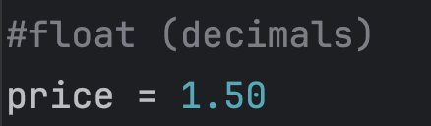
Floats are numbers with decimals
Example:

Slide 24
Integers and Floats can be used to do math (+, -, *, /)

Slide 25
a = 10
b = 5
c = a + b
c = ?
a = 10
b = 5
c = a - b
c = ?
a = 10
b = 5
c = a * b
c = ?
a = 10
b = 5
c = a/b
c = ?

Slide 26
a = 10
b = 5
a + b = 15
a = 10
b = 5
a - b = 5
a = 10
b = 5
a * b = 50
a = 10
b = 5
a/b = 2

Slide 27
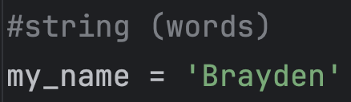
Strings represent sequences of characters or words
Example:

Slide 28
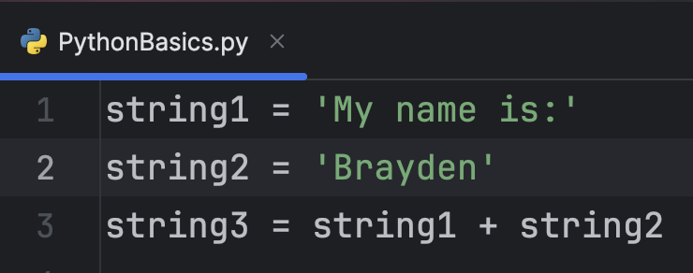
You can use a “+” to join strings!
Example:

Slide 29
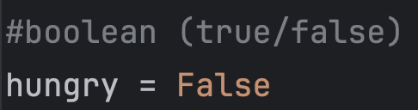
Booleans are either true or false
Example:

Slide 30
Lists and Tuples are similar but different

Slide 31
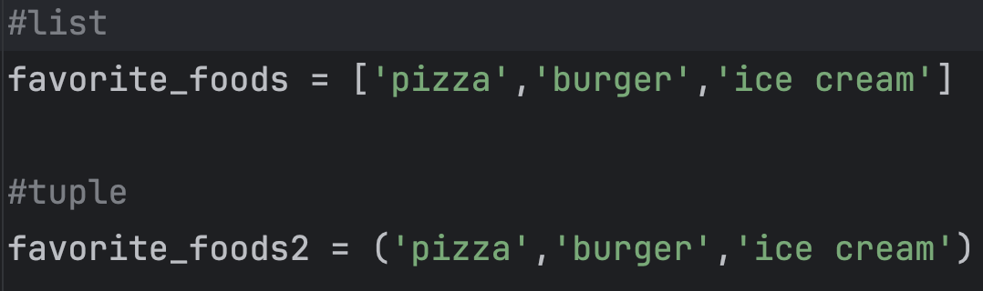
Lists and Tuples are both used to store multiple values. Think of them as baskets of variables.

Slide 32
Lists are changeable []
Tuples are NOT changeable ()

Slide 33
Try it Yourself!
Write code (using variables!) to hold data about yourself. Use at least one of each : Integer, String, Boolean, List.

Slide 34
We can print variables simply by using a print() statement

Slide 35
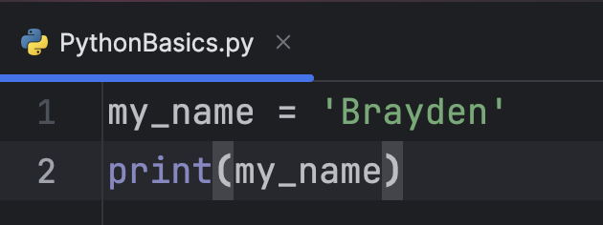

Slide 36
Prints ‘Brayden’

Slide 37
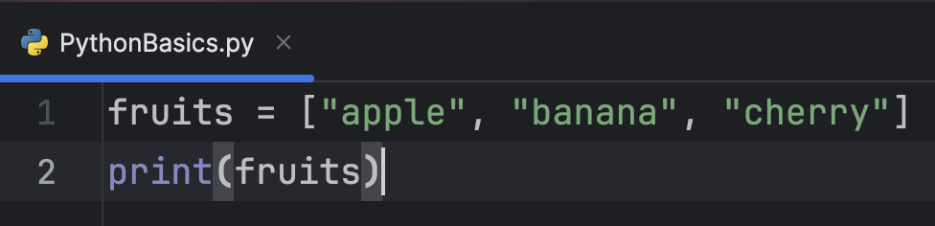

Slide 38
Prints ['apple', 'banana', 'cherry']

Slide 39
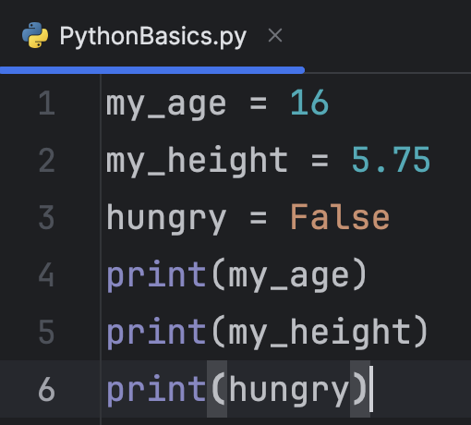

Slide 40
Prints: 16 5.75
False

Slide 41
1.3 Conditionals

Slide 42
A conditional is a statement that allows a program to continue only if a specified condition is met

Slide 43
The most common conditional is an If statement

Slide 44
An If statement uses comparison operators that allows the code to run only if a condition is met

Slide 45
equals: ==
does not equal: !=
less than: < less than or equal to: <= greater than: > greater than or equal to: >=

Slide 46
→
6 > 3
?
→
7 > 9
?
→
5 == 5
?
→
8 <= 6
?
→
7 != 0
?

Slide 47
→
6 > 3
True
→
7 > 9
False
→
5 == 5
True
→
8 <= 6
False
→
7 != 0
True

Slide 48
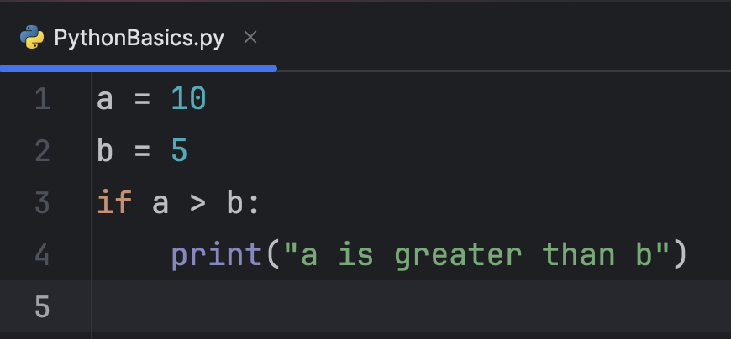
Condition
What does this code print?
Indentation

Slide 49
We can use logical operators to combine or modify conditions

Slide 50
The three logical operators are: and, or, not

Slide 51
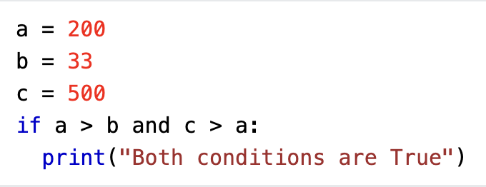
and combines conditional statements

Slide 52
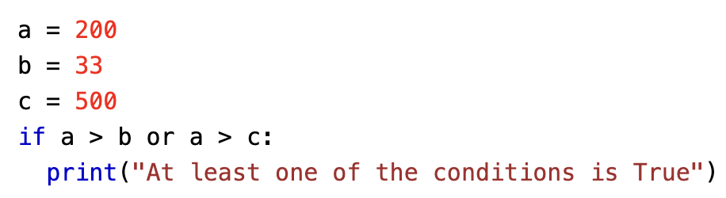
or combines conditional statements

Slide 53
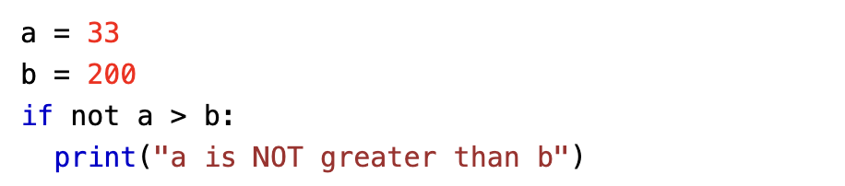
not reverses the result of conditional statements

Slide 54
Elif (else if) and else

Slide 55
Elif is python’s way of saying “if the previous condition wasn’t true, then try this condition”

Slide 56
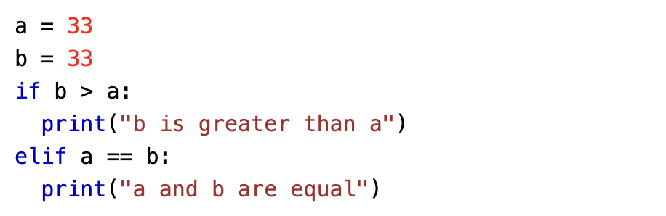

Slide 57
Else is the code that is ran if none of the other conditions are true

Slide 58
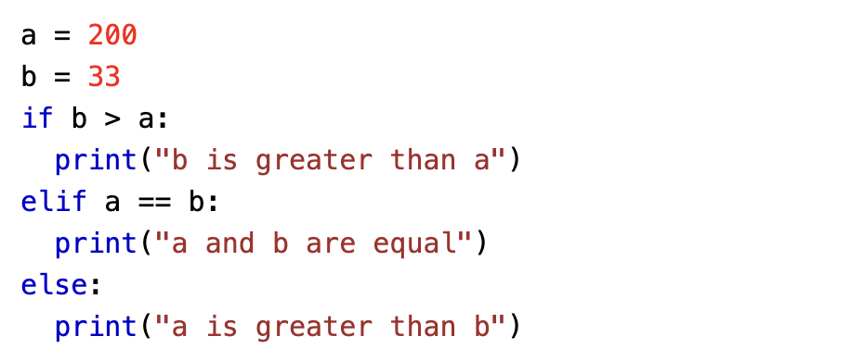

Slide 59
Try it Yourself!
Write code that compares two numbers to find out which is greater.

Slide 60
1.4 Loops

Slide 61
We will cover two types of loops in python: for loops and while loops

Slide 62
While loops are used to repeat code as long as a certain condition is true

Slide 63
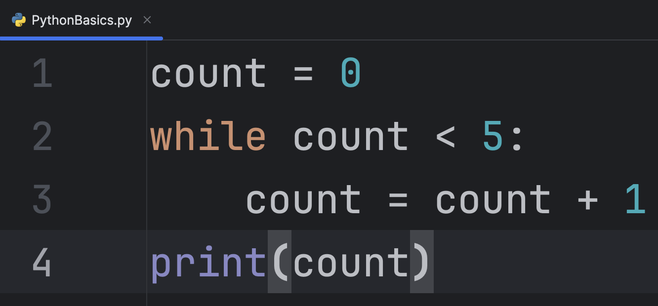
Condition
Repeated code
Indentation

Slide 64
What does this code print?

Slide 65
For loops are used to repeat code a specific number of times

Slide 66
The easiest way to use a For loops is with the range() statement

Slide 67
Range makes a range of number, starting from 0, and incrementing by 1, and stops before a specified number

Slide 68
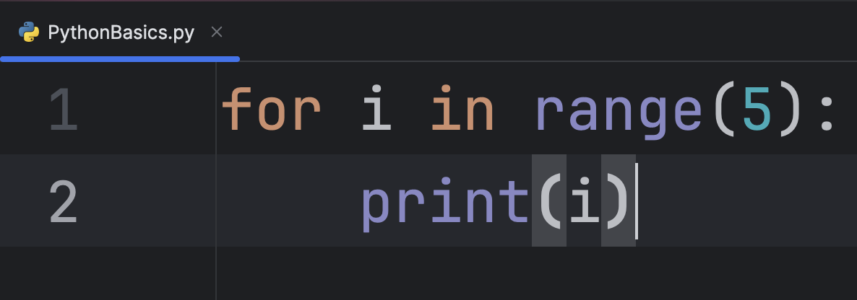
Range of numbers
Indentation
Repeated code

Slide 69
What does this code print?

Slide 70
Try it Yourself!
Write code using a for loop or while loop to make a countdown from 5 and then print ‘liftoff!’

Slide 71
Print:
5
4
3
2
1
Liftoff!

Slide 72
